Slide 1
Face Presentation attack Detection Using Deep Reinforcement Learning
Guide
Dr. R. Shyamala M.E..Phd.,AP/IT
Team members
Arulkumaran R (422419205003)
Jabaselvi A (422419205015)
Navieen R (422419205022)

Slide 2
Proposed solution
S. No | Parameter | Description
1 | Problem statement | To develop a face presentation attack detection and prevention system using deep reinforcement learning.
2 | Idea/Solution description | Idea is to solve this issue using neural network-based reinforcement learning system to correlate between real faces and attacks.
3 | Novelty/Uniqueness | Usage of reinforcement learning in real time.
4 | Social impact/customer satisfaction | Improved safety and security make the Face recognition system more reliable.
5 | Business model (Revenue model) | Face recognition system becomes commercially efficient when error rate is low.
6 | Scalability of the solution | Tries to provide more accurate results by using real time data.
S. No | Parameter | Description
1 | Problem statement | To develop a face presentation attack detection and prevention system using deep reinforcement learning.
2 | Idea/Solution description | Idea is to solve this issue using neural network-based reinforcement learning system to correlate between real faces and attacks.
3 | Novelty/Uniqueness | Usage of reinforcement learning in real time.
4 | Social impact/customer satisfaction | Improved safety and security make the Face recognition system more reliable.
5 | Business model (Revenue model) | Face recognition system becomes commercially efficient when error rate is low.
6 | Scalability of the solution | Tries to provide more accurate results by using real time data.

Slide 3
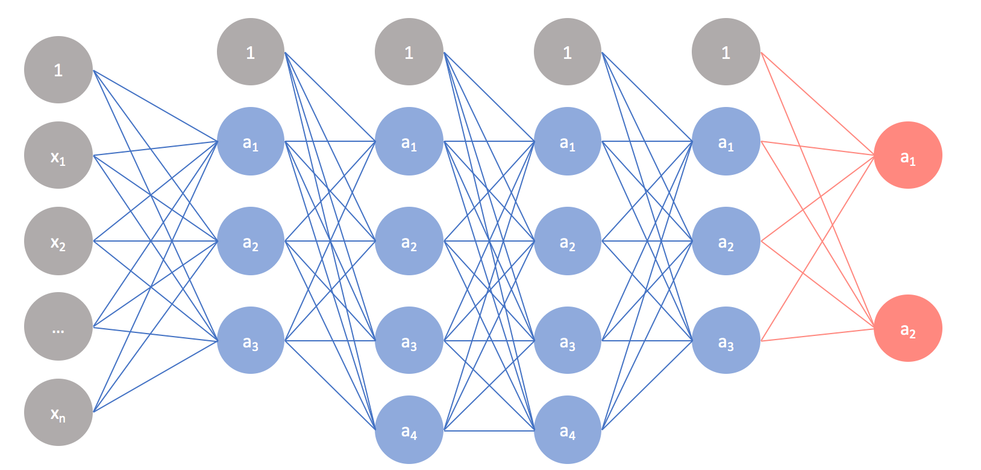
System Architecture Batch -03
Input
Feature Extraction
CNN Module
Classification
Evaluation
CASIA_MFSD Dataset
Training dataset
Frame capture
BPCER
Principal Component Analysis (PCA)
Live video
Haar cascade (256x256)
Pooling layer
APCER
CNN (3 Layers)
Support Vector Machine (SVM)
Deep face extraction
ReLU
ACER

Slide 4
Module Split-up:
Implementation of this project is divided into three modules:
Feature extraction
Module Building
Classification

